Slide 1
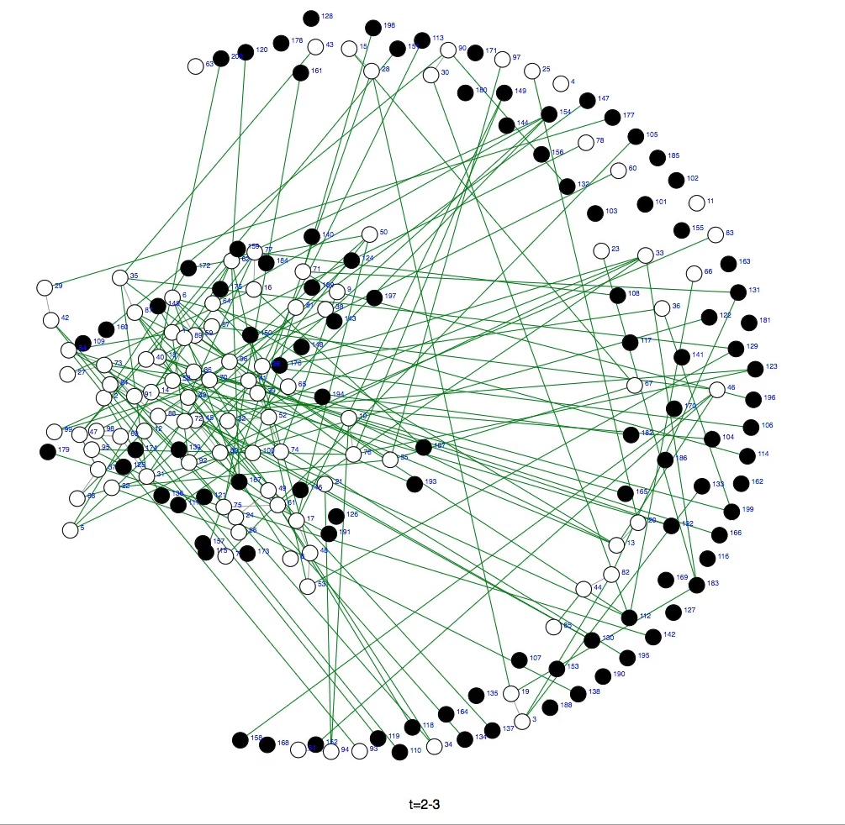
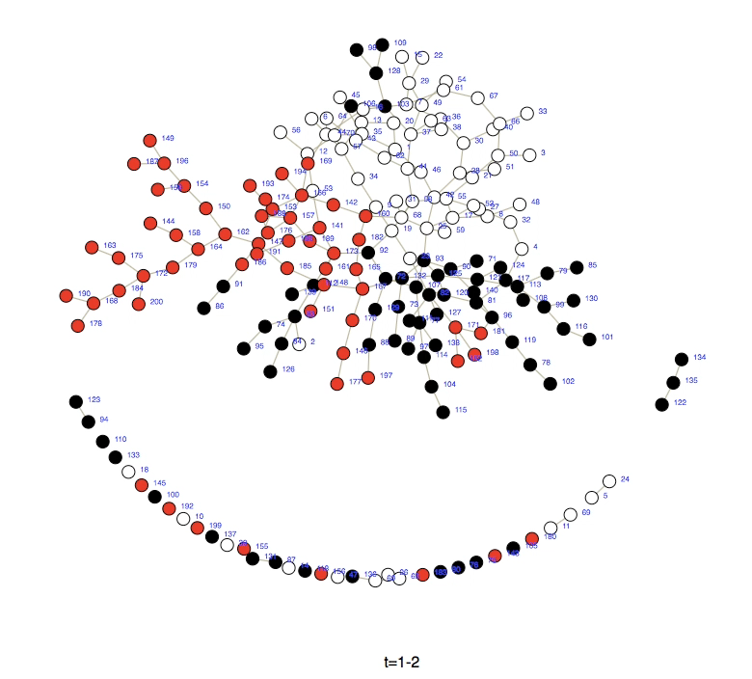
Homophily by race
(white = low SES, black = high SES)
Homophily by race
(colors indicate 3 races)

